Slide 1
Advanced Sequencing Technologies & Bioinformatics Analysis (Virtual)
http://meetings.cshl.edu/courses.html

Slide 2
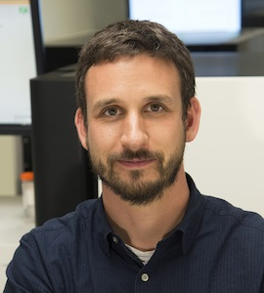
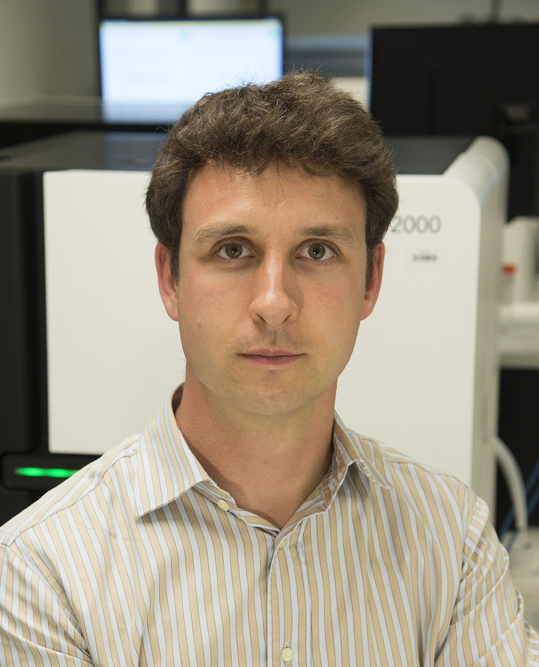
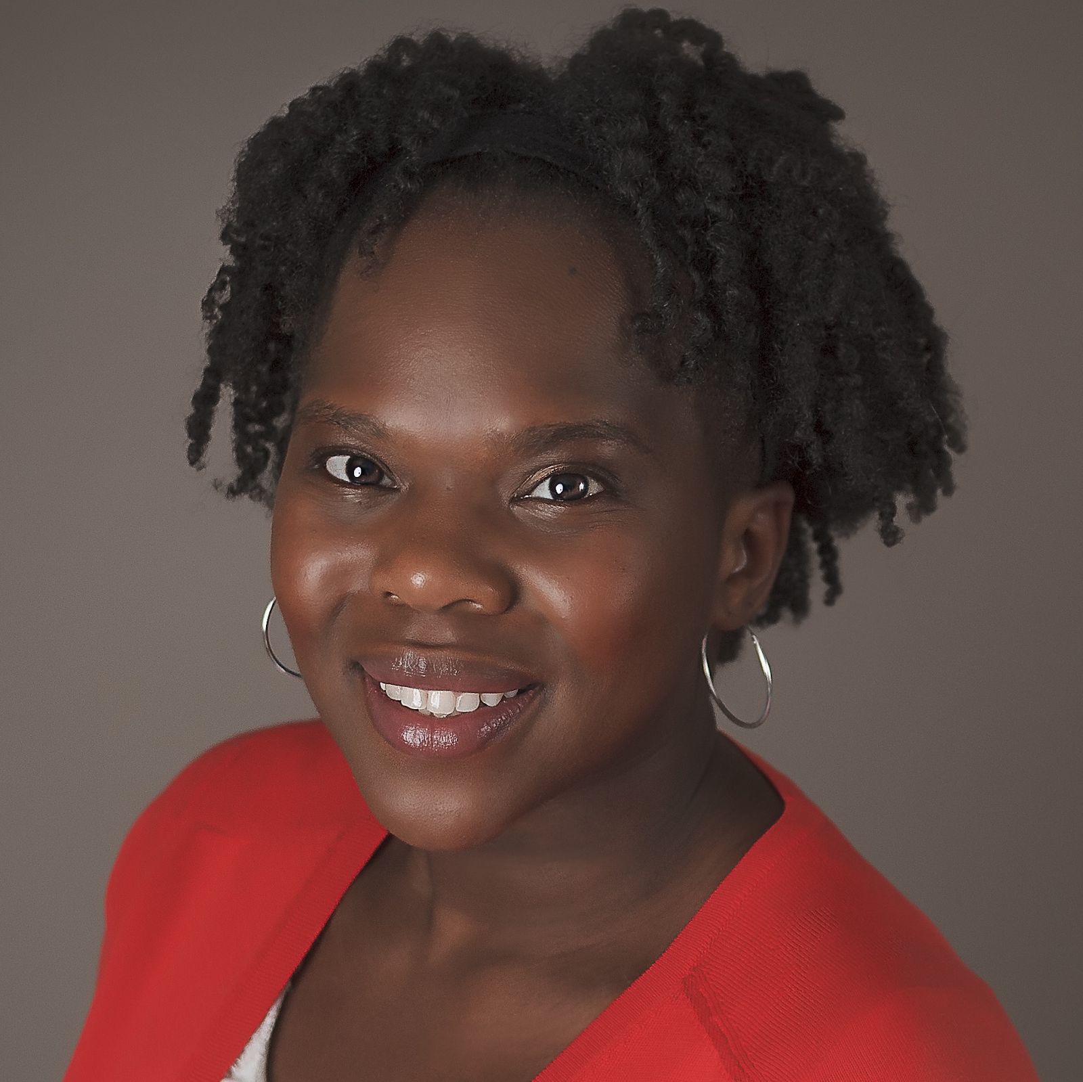
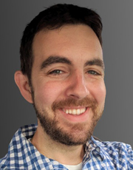
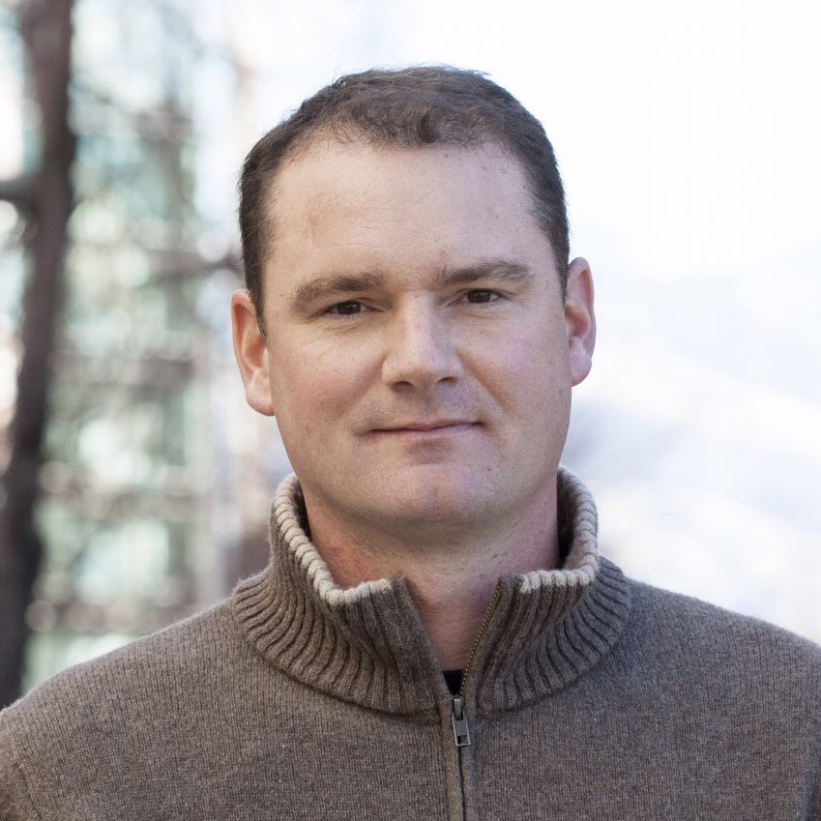
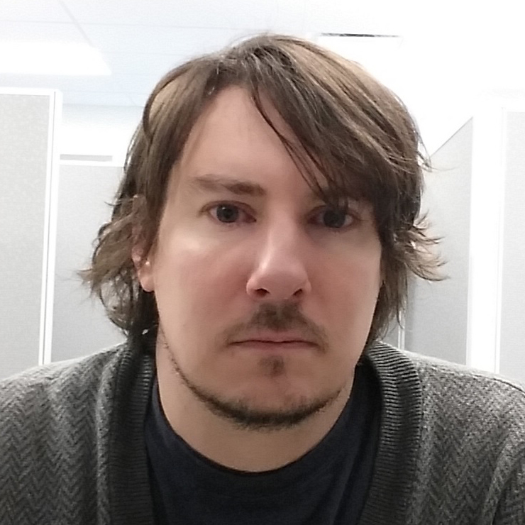
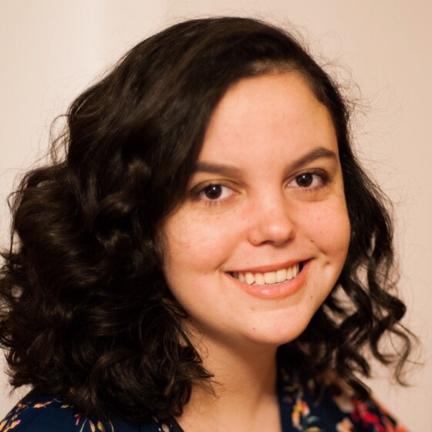
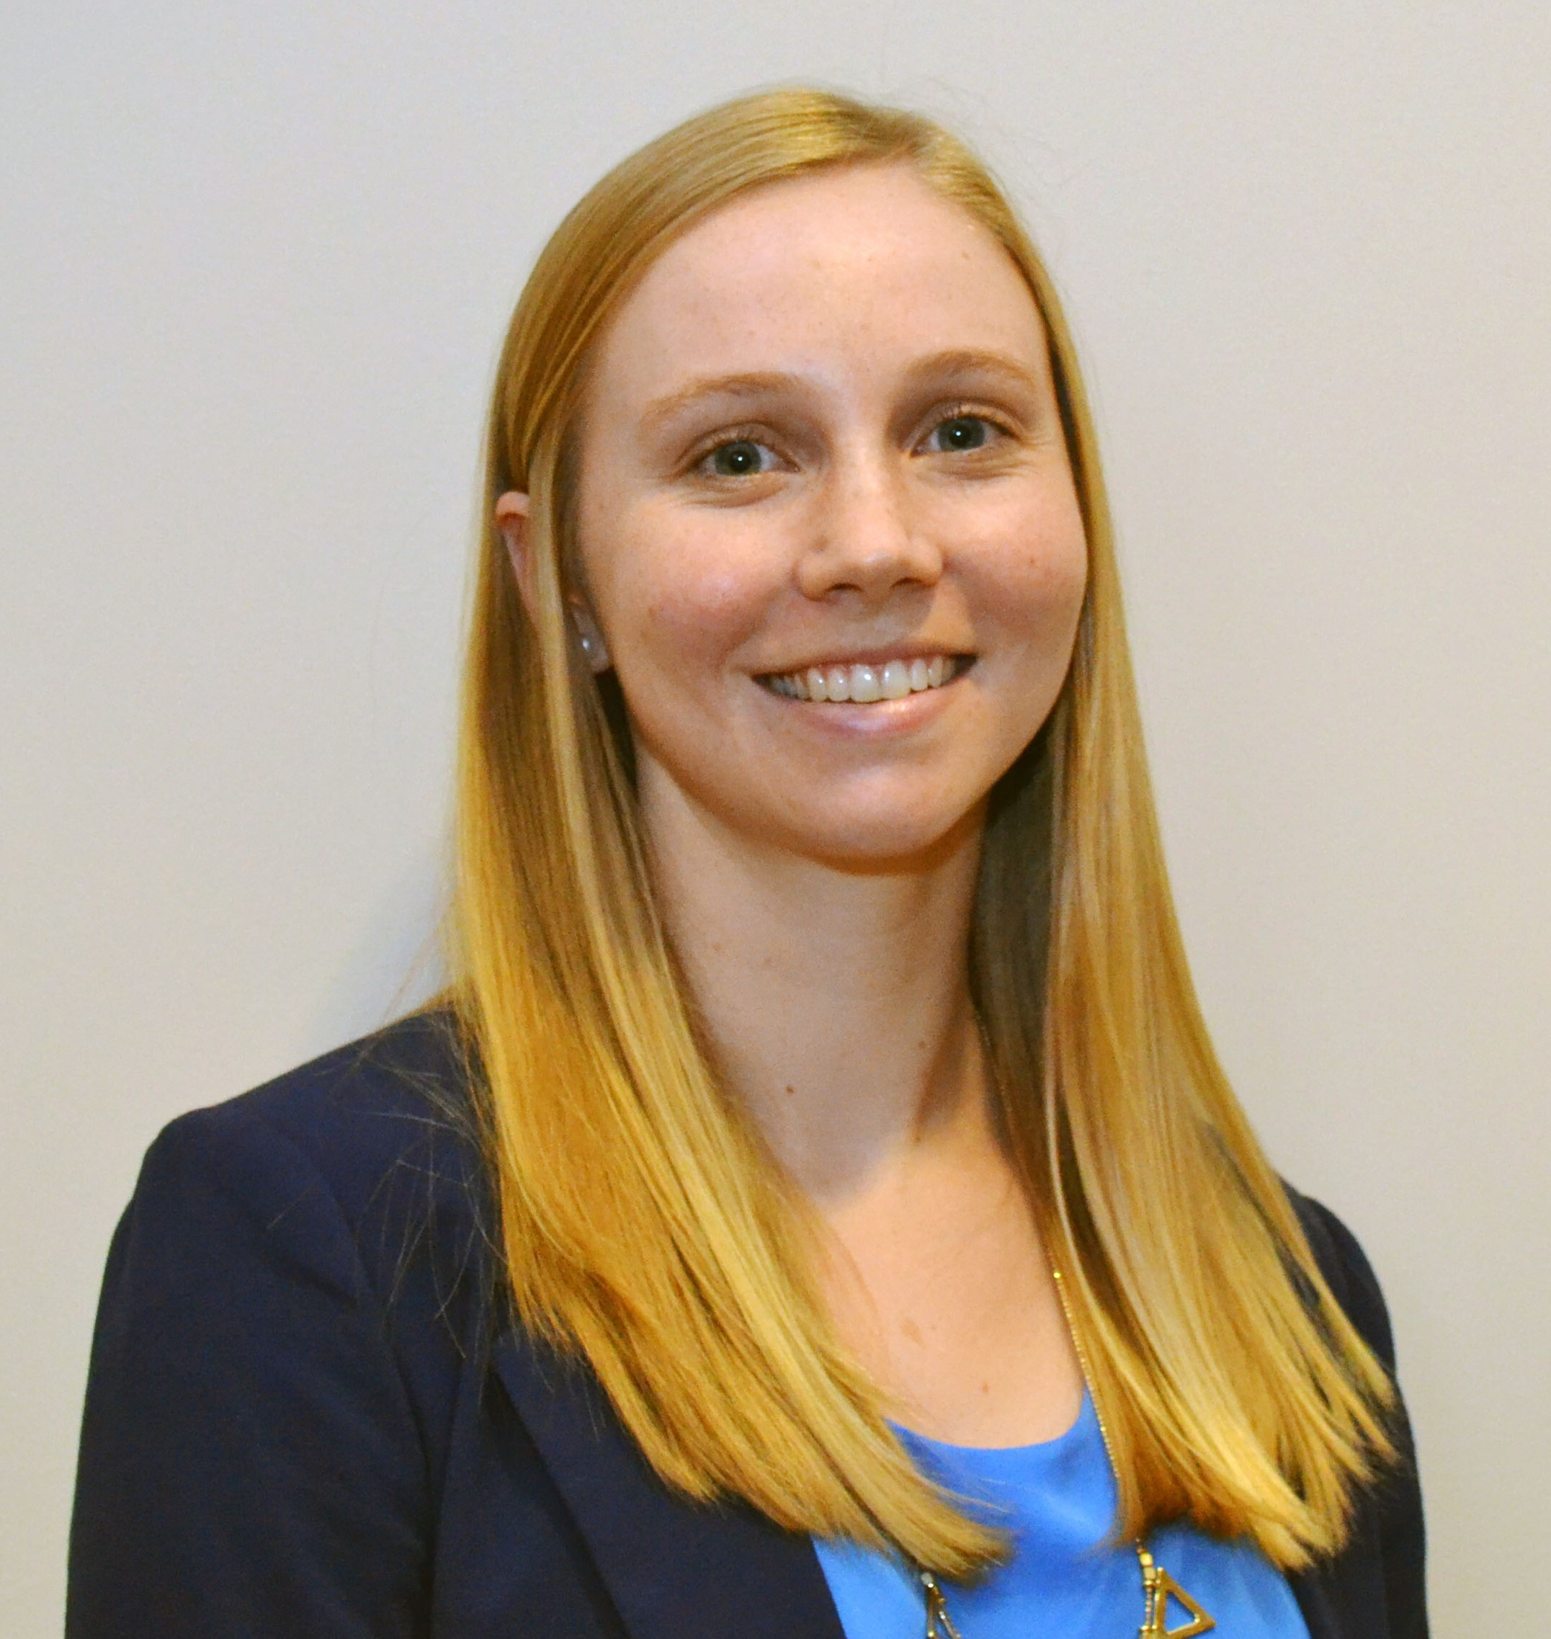
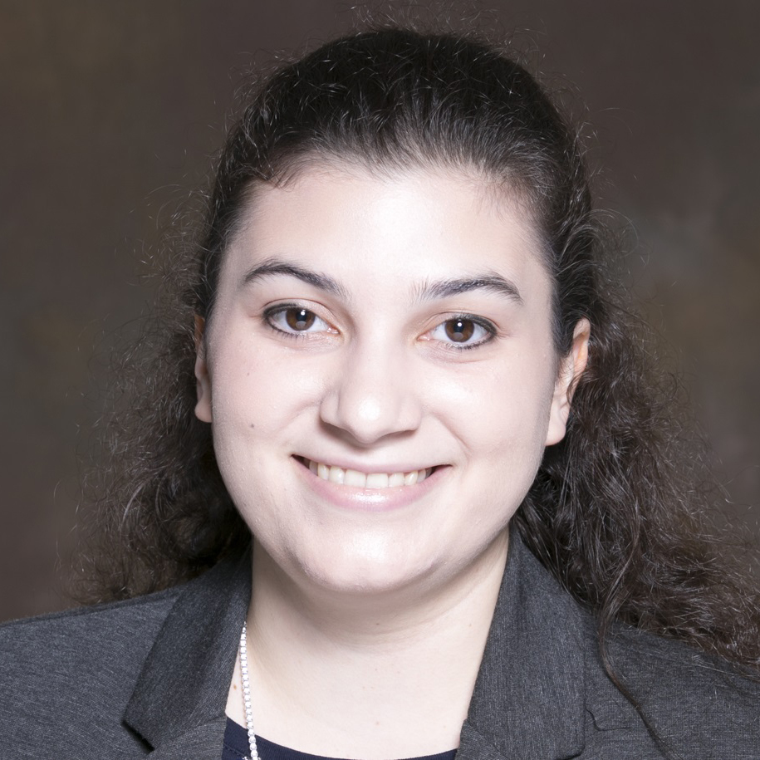
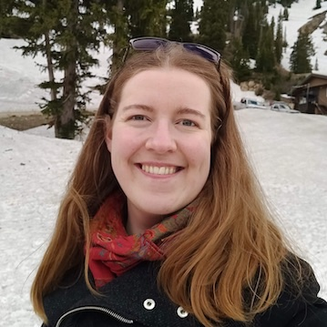
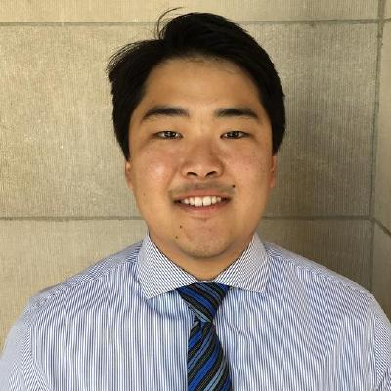



Introductions to Bioinformatics instructors
Malachi Griffith Associate Professor of Medicine Associate Professor of Genetics
Assistant Director, MGI
Obi Griffith
Associate Professor of Medicine Associate Professor of Genetics
Assistant Director, MGI
Felicia Gomez
Instructor of Medicine
Aaron Quinlan
Professor of Human Genetics and of Biomedical Informatics
Chris Miller
Assistant Professor of Medicine
Arpad Danos
Postdoc
Kelsy Cotto
PhD candidate
Megan Richters
PhD candidate
Sharon Freshour
PhD candidate
Harriet Dashnow
Postdoc
Jason Kunisaki
Graduate Student
griffithlab.org
rnabio.org genviz.org pmbio.org
quinlanlab.org

Slide 3
Introduction to SEQTEC Informatics – philosophy and goals
Do “the bioinformatics” for someone, and you help them for a day. Teach someone to do bioinformatics, and you help them for a lifetime.
- Ancient Chinese proverb
Course goals
Learn concepts and develop skills for sequence analysis
Build the foundation for tackling your own analysis challenges
Learn to think like a bioinformatician
Have fun

Slide 4
Course outline
Thursday - Introduction to technologies
Friday - Bioinformatics basics and NGS data fundamentals
Monday - Variant calling/interpretation, RNAseq introduction
Tuesday - RNAseq expression analysis
Wednesday - RNAseq differential expression and interpretation
Thursday - Single cell RNAseq
Friday – Additional applications

Slide 5
Course format for a typical day
Lecture
BREAK
Practical exercises
Lunch
Practical exercises
BREAK
Practical exercises
Wrap-up and Q&A

Slide 6
Student poll (respond in slack)
Not counting the pre-requisites and materials for this course:
Do you consider yourself a bioinformatician?
Are you familiar with linux/command line?
Intermediate?
Expert?
Do you sometimes write code?
Are you familiar with R?
Intermediate?
Expert?
Do you use git/github?
What organism do you work with? (Put an animal emoji in slack)
Are you interested in bulk RNAseq, scRNAseq, or both?
Who has a dual monitor setup?

